Slide 1

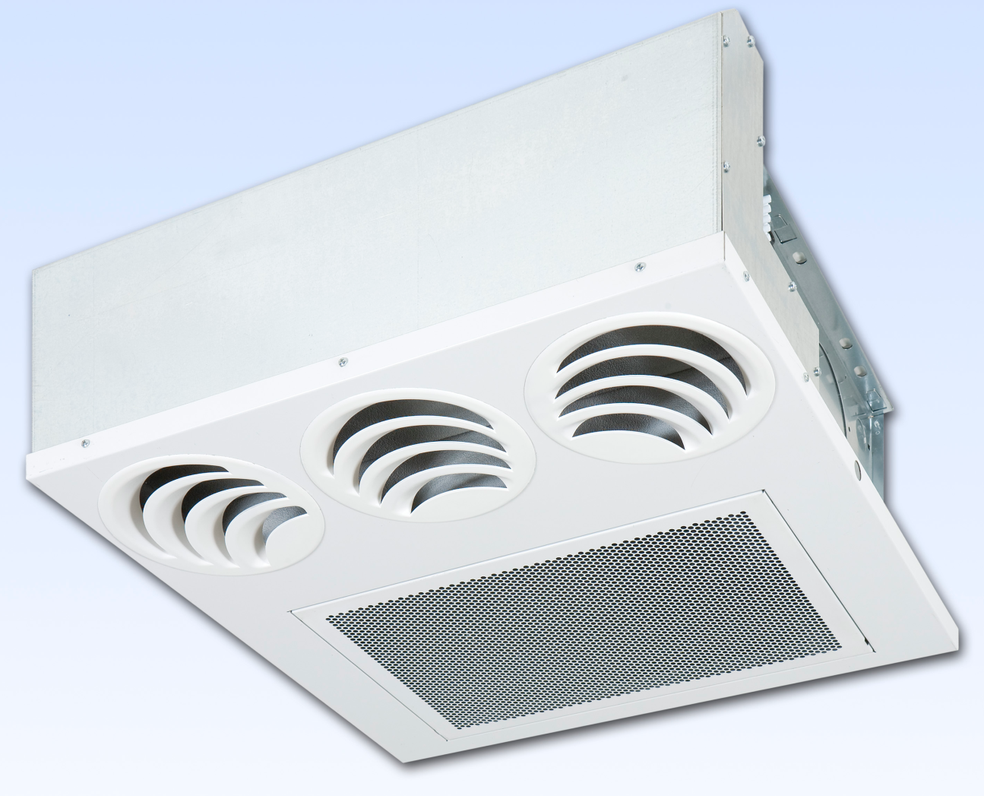
YFCC ‘COANDA’ CASSETTE UNITS

Slide 2
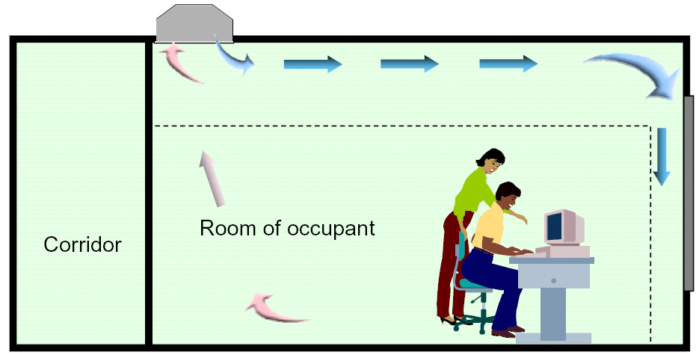
YFCC units are an evolution of YFCN concealed version and thanks to the particular air handling section, YFCC units generate an airflow with a “COANDA” effect.
The unit is suitable for installation in a suspended ceiling
Air intake is from the bottom while the air supply is parallel to the ceiling.
The “YFCC” effect creates excellent circulation of the air inside the room.
YFCC ‘COANDA’ CASSETTE UNITS

Slide 3
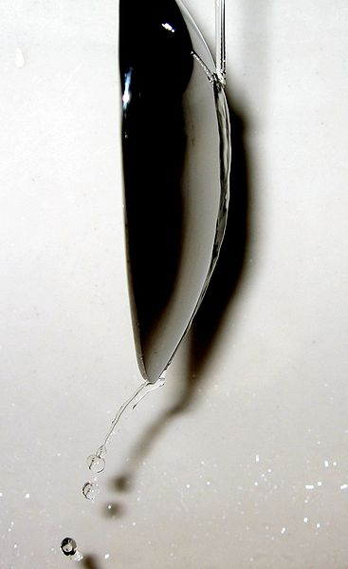
THE ‘COANDA’ EFFECT
The Coandă effect is the tendency of a fluid jet to be attracted to a nearby surface. The principle was named after Romanian aerodynamics pioneer Henri Coandă, who was the first to recognize the practical application of the phenomenon in aircraft development.
The Coandă effect is a result of entrainment of ambient fluid around the fluid jet. When a nearby wall does not allow the surrounding fluid to be pulled inwards towards the jet (i.e. to be entrained), the jet moves towards the wall instead. The fluid of the jet and the surrounding fluid should be essentially the same substance (a gas jet into a body of gas or a liquid jet into a body of liquid). In one application, a jet of air is blown over the upper surface of an airfoil, which can have a strong influence on the overall lift, especially at high angles of attack when the flow would otherwise separate (stall).
The Coandă effect has important applications in various high-lift devices on aircraft, where air moving over the wing can be "bent down" towards the ground using flaps and a jet sheet blowing over the curved surface of the top of the wing. The bending of the flow results in its acceleration and as a result of Bernoulli’s principle pressure is decreased; aerodynamic lift is increased. The flow from a high speed jet engine mounted in a pod over the wing produces enhanced lift by dramatically increasing the velocity gradient in the shear flow in the boundary layer. In this velocity gradient particles are blown away from the surface, thus lowering the pressure there
The effect can be seen by placing a can in front of a lit candle. If one blows directly at the can, the air will bend around it and extinguish the candle.
If two lit candles are placed side-by-side, the heated air from each candle rises and entrains surrounding air. Since both "jets" are trying to entrain common air from the space between the two streams, they are drawn towards one another. This is more apparent if the candles are making a little smoke. This is a demonstration of the Coandă effect without the presence of any surface. In some sense, the plane of symmetry between the two flows can be thought of as the surface.

Slide 4
YFCC ‘COANDA’ DIFFUSERS
YFCC 1
YFCC 2
YFCC 3

Slide 5
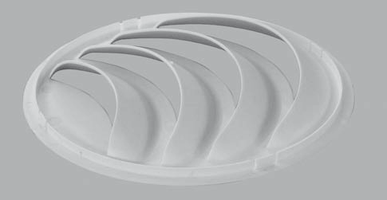
YFCC DIFFUSER DESIGN

Slide 6
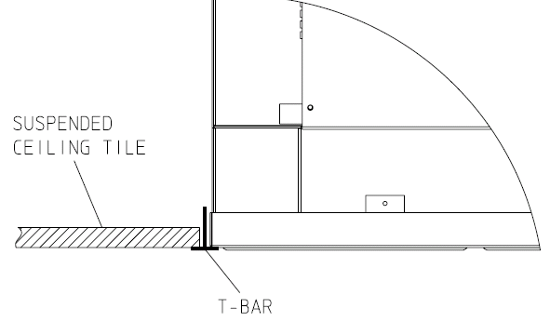
YFCC units are suitable for installation in a suspended ceiling (“T” profile)
YFCC ‘COANDA’ INSTALLATION

Slide 7
YFCC ‘COANDA’ CASSETTE PERFORMANCE
2 pipes units
The following standard rating conditions are used:
COOLING (Summer operation) |  |  |  |  |  | HEATING (winter operation)
Air temperature : +27°C b.s. +19°C b.u. |  |  |  |  |  | Air temperature: +20°C
Water temperature : + 7°C EWT +12°C LWT |  |  |  |  |  | Water temperature: +60°C EWT
 |  |  |  |  |  | Water Temperature: +50°C LWT
MODEL |  | YFCC 13 |  |  |  |  |  | YFCC 23 |  |  |  |  |  | YFCC 33
Speed |  | 1 | 2 | 3 | 4 | 5 | 6 | 1 | 2 | 3 | 4 | 5 | 6 | 1 | 2 | 3 | 4 | 5 | 6
Air flow | m3/h | 140 | 180 | 220 | 245 | 280 | 305 | 200 | 240 | 305 | 380 | 470 | 560 | 290 | 360 | 440 | 540 | 620 | 680
Cooling total emission | kW | 0,88 | 1,06 | 1,26 | 1,35 | 1,50 | 1,60 | 1,37 | 1,62 | 1,97 | 2,37 | 2,81 | 3,23 | 1,97 | 2,37 | 2,84 | 3,34 | 3,75 | 4,05
Cooling sensible emission | kW | 0,66 | 0,81 | 0,98 | 1,06 | 1,18 | 1,27 | 1 | 1,19 | 1,47 | 1,77 | 2,13 | 2,47 | 1,44 | 1,74 | 2,11 | 2,51 | 2,83 | 3,07
Heating | kW | 1,08 | 1,33 | 1,59 | 1,73 | 1,93 | 2,08 | 1,6 | 1,91 | 2,35 | 2,86 | 3,43 | 3,95 | 2,30 | 2,79 | 3,37 | 4,02 | 4,53 | 4,88
DP Cooling | kPa | 2,4 | 3,3 | 4,5 | 5,1 | 6,1 | 6,8 | 2,9 | 3,9 | 5,5 | 7,6 | 10,3 | 13,1 | 6,4 | 8,8 | 12,1 | 16,2 | 19,8 | 22,7
Dp Heating | kPa | 1,8 | 2,6 | 3,5 | 4,0 | 4,9 | 5,6 | 2,3 | 3,1 | 4,5 | 6,3 | 8,4 | 10,8 | 5,2 | 7,3 | 9,8 | 13,4 | 16,3 | 18,6
Fan (E) | W | 16 | 22 | 32 | 38 | 49 | 66 | 24 | 27 | 34 | 44 | 57 | 71 | 27 | 33 | 42 | 59 | 72 | 84
Sound power Lw | dB(A) | 35 | 41 | 46 | 49 | 52 | 55 | 33 | 36 | 42 | 48 | 54 | 57 | 35 | 41 | 46 | 52 | 55 | 57
Sound pressure Lp | dB(A) | 26 | 32 | 37 | 40 | 43 | 46 | 24 | 27 | 33 | 39 | 45 | 48 | 26 | 32 | 37 | 43 | 46 | 48

Slide 8
YFCC ‘COANDA’ CASSETTE PERFORMANCE
2 pipe units
The following standard rating conditions are used:
COOLING (Summer operation) |  |  |  |  |  | HEATING (winter operation)
Air temperature : +27°C b.s. +19°C b.u. |  |  |  |  |  | Air temperature: +20°C
Water temperature : + 7°C EWT +12°C LWT |  |  |  |  |  | Water temperature: +60°C EWT
 |  |  |  |  |  | Water temperature: +50°C LWT
MODEL |  | YFCC 14 |  |  |  |  |  | YFCC 24 |  |  |  |  |  | YFCC 34
Speed |  | 1 | 2 | 3 | 4 | 5 | 6 | 1 | 2 | 3 | 4 | 5 | 6 | 1 | 2 | 3 | 4 | 5 | 6
Air flow | mc/h | 140 | 180 | 220 | 245 | 280 | 305 | 200 | 240 | 305 | 380 | 470 | 560 | 290 | 360 | 440 | 540 | 620 | 680
Cooling total emission | kW | 0,97 | 1,19 | 1,44 | 1,55 | 1,74 | 1,87 | 1,44 | 1,72 | 2,12 | 2,57 | 3,09 | 3,58 | 2,05 | 2,49 | 3,00 | 3,56 | 4,02 | 4,36
Cooling sensible emission | kW | 0,71 | 0,88 | 1,07 | 1,17 | 1,31 | 1,42 | 1,04 | 1,24 | 1,54 | 1,88 | 2,28 | 2,67 | 1,48 | 1,81 | 2,20 | 2,63 | 2,98 | 3,25
Heating | kW | 1,14 | 1,42 | 1,72 | 1,88 | 2,10 | 2,27 | 1,69 | 2,03 | 2,54 | 3,12 | 3,79 | 4,44 | 2,38 | 2,90 | 3,51 | 4,20 | 4,77 | 5,20
DP Cooling | kPa | 4,7 | 6,7 | 9,2 | 10,6 | 12,9 | 14,6 | 4,4 | 6,0 | 8,6 | 12,1 | 16,8 | 21,7 | 4,7 | 6,7 | 9,3 | 12,6 | 15,5 | 17,9
Dp Heating | kPa | 3,7 | 5,4 | 7,6 | 8,8 | 10,7 | 12,3 | 3,5 | 4,8 | 7,1 | 10,2 | 13,6 | 17,9 | 3,9 | 5,5 | 7,3 | 10,0 | 12,6 | 14,6
Fan (E) | W | 16 | 22 | 32 | 38 | 49 | 66 | 24 | 27 | 34 | 44 | 57 | 71 | 27 | 33 | 42 | 59 | 72 | 84
Sound power Lw | dB(A) | 35 | 41 | 46 | 49 | 52 | 55 | 33 | 36 | 42 | 48 | 54 | 57 | 35 | 41 | 46 | 52 | 55 | 57
Sound pressure Lp | dB(A) | 26 | 32 | 37 | 40 | 43 | 46 | 24 | 27 | 33 | 39 | 45 | 48 | 26 | 32 | 37 | 43 | 46 | 48

Slide 9
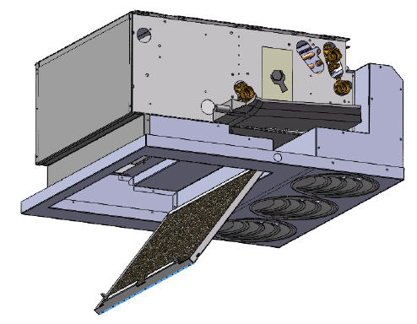
YFCC ‘COANDA’ CASSETTE CONSTRUCTION FEATURES
Polypropylene cellular fabric regenerating filter
Inside thermal insulation, closed cell polyethylene 6 mm thick, class M1
Diffuser and intake grille in prepainted metal sheet in RAL 9003 colour.
Plastic round diffusers. The direction of air flow diffusers can be easily adjusted on site.
Main heat exchanger - 3 or 4 rows
Additional heat exchanger - 1 or 2 rows (2 rows for 3+2 only)
Filter access panel

Slide 10
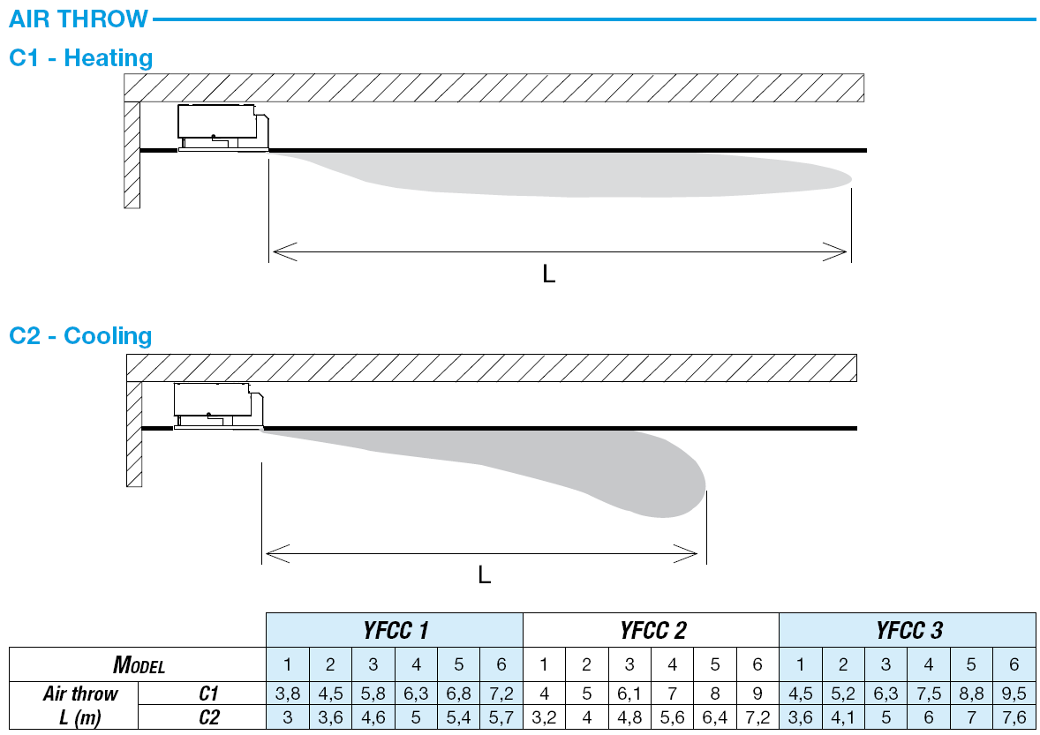
YFCC ‘COANDA’ CASSETTE – grille coanda effect

Slide 11
YFCC ‘COANDA’ CASSETTE INSTALLATION NOTES
If the air flow is blown against an obstacle on the ceiling, the Coanda effect is stopped and the air flow is directed downwards to the floor.
Same result is obtained if two YFCC units are installed one in front of the other. The meeting point of the two air flows produces the same effect as an obstacle on the ceiling, thus directing the air flow downwards to the floor.
Height of installation : min 2,6 m – max 3,2 m (YFCC 1-2) 3,5 m (YFCC3)
The working speed of the fan-coil has to be selected in accordance to room dimensions and above mentioned air throw diagrams

Slide 12
YFCC ‘COANDA’ CASSETTE – AVAILABLE ACCESSORIES
Condensate drain pump
Electric heater with integral: safety thermostat and relay control.
Auxiliary condensate Collection Tray
2 or 3 way valve Kit
Wall electronic controls

Slide 13
YFCC ‘COANDA’ CASSETTE ORIGINS
Accessories, controls and wiring diagrams are the same of YFCN CD concealed model
YFCC 1 unit is made from YFCN 2
YFCC 2 unit is made from YFCN 5
YFCC 3 unit is made from YFCN 7

Slide 14
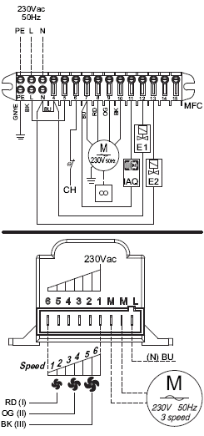
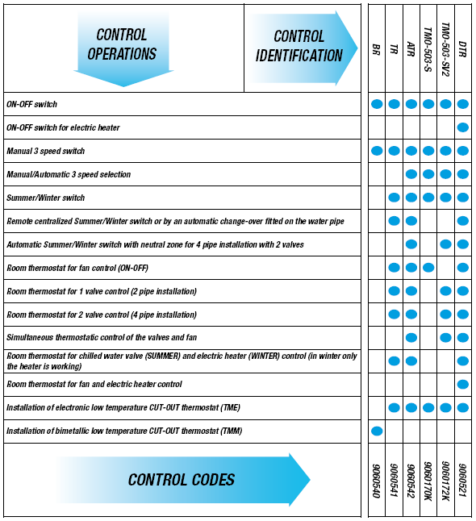
YFCC ‘COANDA’ CASSETTE CONTROL OPTIONS

Slide 15
YFCC ‘COANDA’ CASSETTE – REMOTE CONTROL OPTIONS
Type: BR
ON-OFF switch and 3 speed switch.
Type: TR
Electronic room thermostat for fan or valves control (ON-OFF).

Slide 16
YFCC ‘COANDA’ CASSETTE REMOTE ELECTRONIC CONTROLS
Type: ATR
Automatic speed switch.
With 4 pipe installations and continuous chilled and hot water supply, it allows the automatic summer/winter change-over in accordance to the room temperature (-1°C = Winter, +1°C = Summer, Neutral Zone 2°C).
Type: TMO-503 and TMO-503-SV2
The TMO 503 control, with a big and clear display, is designed to be installed in a series 503 wall box.
Type: REC-S
Speed switch (Slave):it allows to control up to 8 units

Slide 17
YFCC ‘COANDA’ CASSETTE REMOTE ELECTRONIC CONTROLS
Type: DTR
Multi-function control with liquid crystall display.
Type: REC-D
Speed switch (Slave):it allows to control up to 10 units with only one DTR control

Slide 18
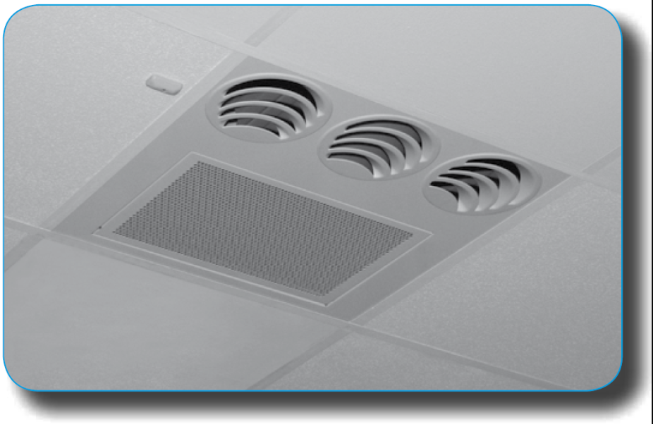
YFCC ‘COANDA’ CASSETTE – INFRA RED REMOTE CONTROLS
The YFCC units can be supplied with a microprocessor managing system operated by an infra-red remote control with liquid crystall display.
A group of YFCC units with infra-red remote control microprocessor can be connected via a serial link and can consequently be managed at the same time by just one infra-red remote control.

Slide 19
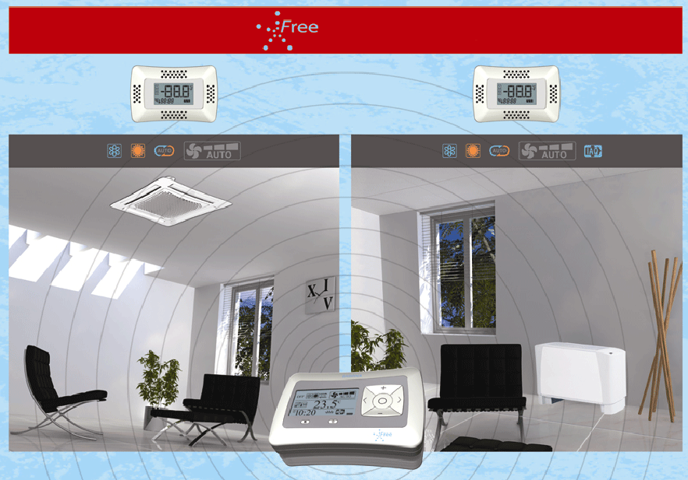

The wireless control system

Slide 20
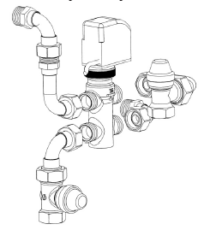
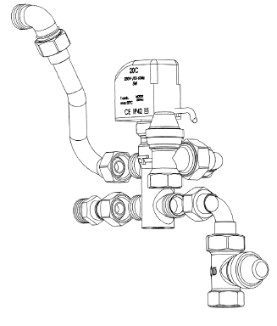
YFCC ‘COANDA’ CASSETTE – JCI VALVE OPTIONS (FACTORY FITTED)
MBV – Main coil 3 way valve
  3 way valve, ON-OFF,
  with electric motor and mounting kit
  with micrometric lockshield valve.
ABV – Additional coil 3 way valve
  3 way valve, ON-OFF,
  with electric motor and mounting kit
  with micrometric lockshield valve.

Slide 21
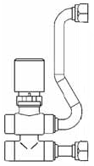
YFCC ‘COANDA’ CASSETTE – JCI VALVE OPTIONS (FACTORY FITTED)
VS - Simplified kit for 3 way valve(concealed model only)
3 way valve, (ON-OFF) with electric motor and mounting kit.
Valve with flat connection without micrometric lockshield valve.
V2 - 2 way valve for main and additional coil
  Control valve kit: 2 way valve, ON-OFF,
  with electric motor and mounting kit.

Slide 22

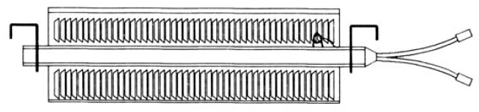
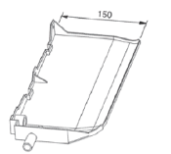
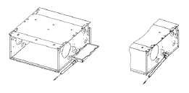
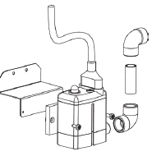

YFCC ‘COANDA’ CASSETTE – OTHER ACCESSORIES
BEL Electric heating element
Designed for use as complimentary heating
  ACTH Condensate collection tray to encompass valve assembly
  SCR Condensate drain pipe
PCC Condensate drain pump

Slide 23
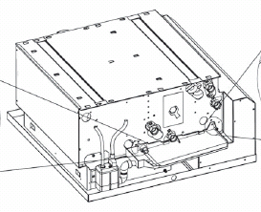
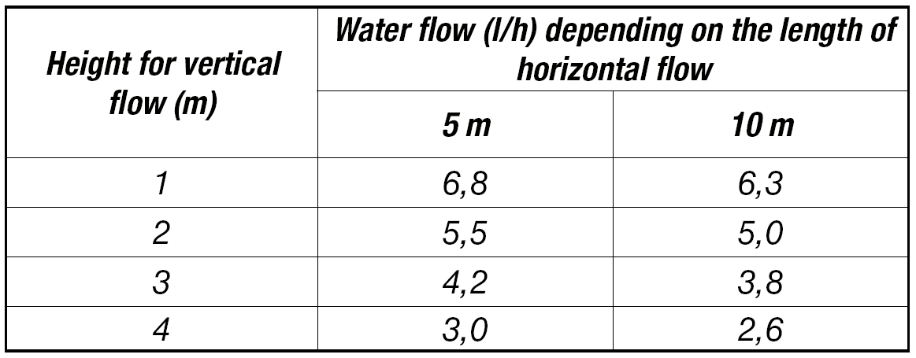
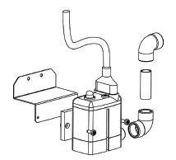
YFCC ‘COANDA’ CASSETTE – CONDENSATE PUMP OPTION

